Slide 1
ACNC: the future of financial reporting
Melville Yates
Director | Reporting, Red Tape Reduction & Corporate Services
Australian Charities and Not-for-profits Commission
Friday 12 April 2019

Slide 2
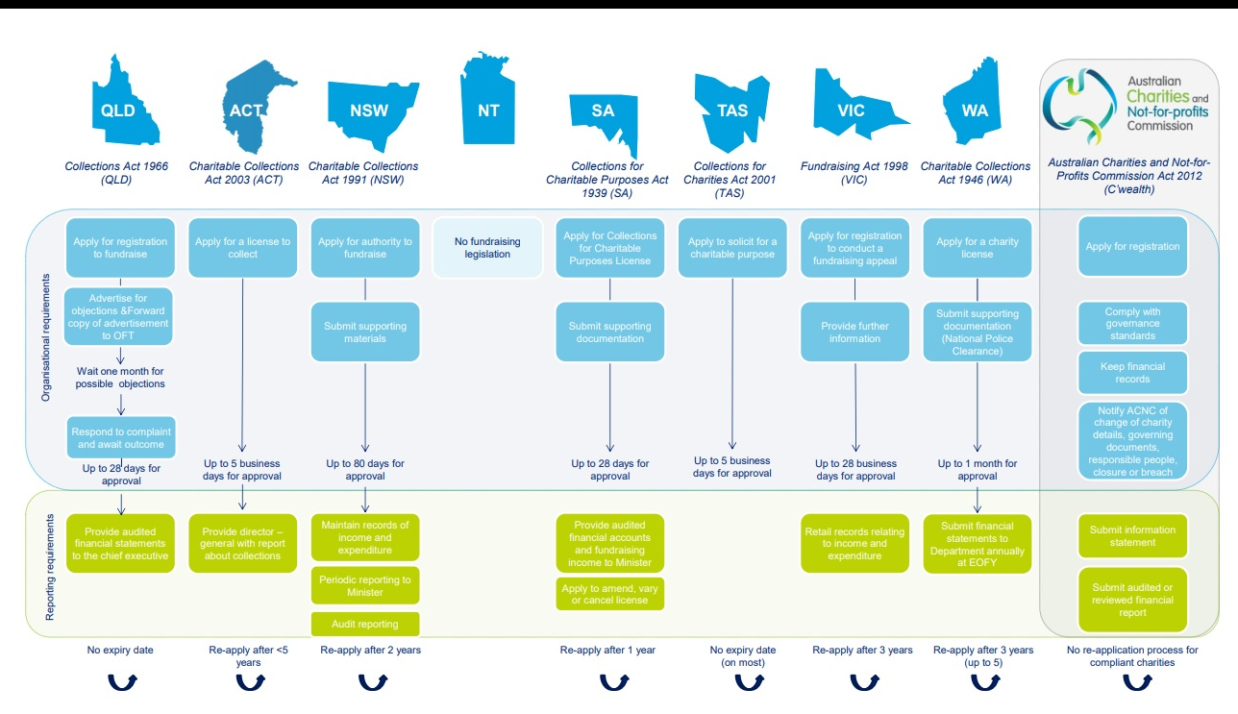

Slide 3
Current reporting - acnc charities
Charity Size | Small | Medium | Large
Annual Revenue | < $250,000 | $250,000 > $1 million | > $1 million
AIS Required? | Yes | Yes | Yes
Financial report? | Optional | Required | Required
Assurance? | Optional | Review or audit | Audit
Reporting method | Cash or accrual | Accrual | Accrual

Slide 4
Relieving the burden
Transitional reporting arrangements
  temporary
  Legislative review recommendation:
    Make transitional arrangements permanent
Keep working with remaining States & Territory
Australian Accounting Standards Board:
  revising the financial reporting framework

Slide 5
Is Current Reporting adequate?
Donor interest in performance
  (financial accountability)?
Initiatives:
  Extended External Reporting
  Integrated Reporting
  Impact Reporting….
Not required in Australia
ACNC see value in exploring impact reporting
  supplement financial reporting

Slide 6
What’s next?
No current framework to support consistent recording, measuring, reporting of impact
Your journey on service performance reporting:
  Tier 3 and 4 – in place
  Tier 1 and 2 – coming
Australia has a lot to learn from you

Slide 7



neighbours
Close proximity
Far away in our reporting journeys
New Zealand can provide insight to Australia

